Slide 1

Basic Details of the Team and Problem Statement
Ministry/Organization Name/Student Innovation:
Ministry of Commerce and Industries
PS Code: SIH1385
Problem Statement Title: Developing a software that can translate resource material and other texts from English to other Indian regional languages
Team Name: Team 404
Team Leader Name: Mustafa Masuldar
Institute Code (AISHE): C-15716
Institute Name: N. B. Navale Sinhgad College of Engineering , Solapur.
Theme Name: Smart Education

Slide 2
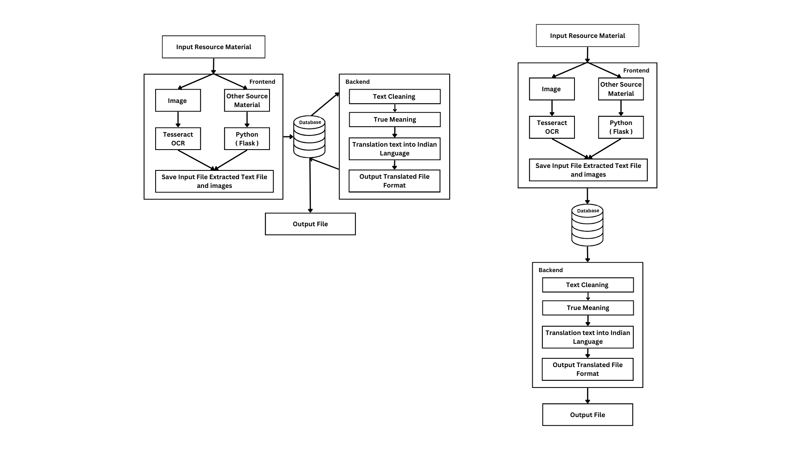
Idea/Approach Details
Our software will empower users to effortlessly translate resources and texts from English into a multitude of Indian languages, seamless communication and access to information
User Input: User can enter text in English or upload documents through CIPAM website.
Image Clarity Enhancement: We use OpenCV to sharpen images, improving text extraction and translation accuracy.
Text extraction: If it is plain text, we process it directly. Whether it’s a scanned image or document, by using a special tool called Tesseract OCR to convert the image into text.
Database: User can store original inputs and output in our database for reference.
Text Correction: Translator make sure that text correct and Spelling mistakes in extracted text .
Grammatical correction: Gramformer ( library) check and correct any grammatical errors in the text to make it appear correct.
Translation: We use a specialized translation tool to translate the washed and corrected text into the language of user choice.
Output: The user can access the translated text in a variety of formats, such as Word or PDF, Etc.
Technology stack:
Translation API + Flask ( Framework ) + Tesseract OCR
NLP + Python libraries (PyPDF2, Gramformer, Translator ,cv2)
HTML, CSS, JS (Frontend) , PHP

Slide 3
Idea/Approach Details
Use Cases:
Students Content Translation:
Language translator can enable the translation of Students educational materials and textbooks from English into multiple Indian languages.
Government and Public Services:
Translate government announcements, public service information, and official documents into regional languages to ensure that citizens have access to critical information in their native languages.
CIPAM’s Resource Materials :
Language translator addresses translate educational tools and resource materials into Indian regional languages. This includes content in various formats like Word documents, PDFs, and even text within images.
Multilingual businesses Communication:
Real-time translation capabilities can facilitate communication between individuals or businesses speaking different languages.
Government Legal Notices :
Translate government documents into regional languages for easier understanding by law enforcement, judges, and customs officials, ensuring compliance with the law.
Dependencies:
Source Material
Access to a diverse and large dataset for training the translation models
Development of an intuitive and user-friendly interface for users to input text and receive translations.
Show Stoppers:
Translation Quality
Accuracy
Scalability
Resource Materials
Language Expansion
OCR Reliability
Accuracy
Diverse Source Materials
Enhance translation capabilities

Slide 4
Team Member Details
Team Leader Name : Mustafa Masuldar
Branch : Btech Stream : CSE Year : IV
Team Member 1 Name : Sakshi Deshmukh
Branch : Btech Stream : CSE Year : IV
Team Member 2 Name : Pooja Pawar
Branch : Btech Stream : CSE Year : IV
Team Member 3 Name : Nandini Madre
Branch : Btech Stream : CSE Year : IV
Team Member 4 Name : Iram Muchale
Branch : Btech Stream : CSE Year : IV
Team Member 5 Name: Nikita Jagdale
Branch : Btech Stream : CSE Year : III

